Slide 1
Design Consideration and
Introduction to Test Automation
(Selenium as a Web Application Test Automation Tool)
Web Application Testing – II

Slide 2
Client Server Applications

Slide 3
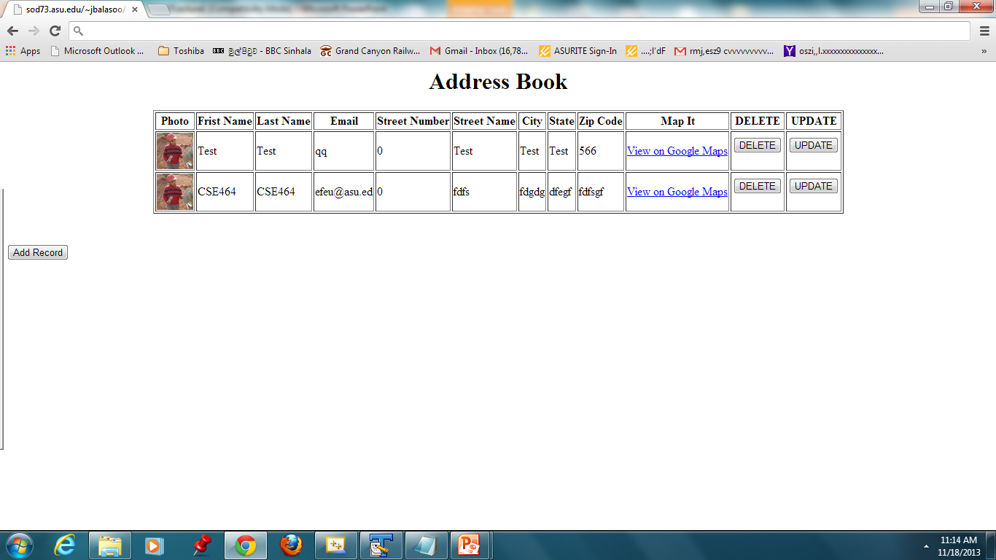

Slide 4
A Typical 3-tier Web Application
Server Scripts – Receives/responds to user calls
Client
Data Management Modules

Slide 5
Client-Server Web Application
AddressBook example

Slide 6
Web Application Testing : Addressbook Version 1
dbconnect.php
Clientt
addressbookses.php
userloginses.html
Insert.php
delete.php
update.php
You can try this application locally using WAMP:
http://www.wampserver.com/en/
Software Architecture: Version 1
DB

Slide 7
Problems with the Current Design of AddressBook

Slide 8
Addressbook Version 2 – Better Design
Clientt
addressbook.php
manageAddress1.php
helper.php
Insert.php
delete.php
update.php
dbconnect.php
DatabaseOpe.php
Test Architecture
DB

Slide 9
Database Testing – A Generic View
Tests are defined for
each layer

Slide 10
Addressbook Test Architecture
Clientt
addressbook.php
manageAddress1.php
UI Test
User Input Test
helper.php
Insert.php
delete.php
update.php
Query Gen Test
Query Gen Test
Query Gen Test
dbconnect.php
DatabaseOpe.php
Database OperationsTest
Test Architecture
DB

Slide 11
Tools in Testing Web Applications
Some unit testing framework to test server side code (phpUnit, simpleTest …etc)
Framework such as DBUnit to test database related functionalities.
Tool such as Selenium to test user scenarios through UI.
A short Article from IBM:
http://www.ibm.com/developerworks/web/library/wa-webapptesting/

Slide 12
What is Test Automation
In general, test automation entails automating a manual process that uses a formalized testing process.
Test Automation
  Saves money and time
  Increases the accuracy
  Faster
  Can do certain things that manual testing can’t do
    Simulating load balancing
    Network traffic …etc

Slide 13
Some Commonly Used Test Automation Tools
Quick Test Professional (QTP) – Java, Windows, and Web
Watir – Ruby
Selenium – Web Applications
LoadRunner (HP) – Mobile and Many varieties of web applications
Rational Performance Tester – Web and Server Applications

Slide 14
What is Selenium
Selenium is a toolkit that can automate web application testing
The Selenium tests can be run on multiple browsers and supports several languages like Java, C#, PHP and Python.
Many assertion statements provide an efficient way of comparing expected and actual results similar to Junit. Here assertion statements can be used to test web content.

Slide 15
Selenium Tool Kit
Selenium RC
(Obsolete)
Selenium IDE
Firefox Only
Run Tests in Parallel in different environments
Selenium
Selenium Grid
Multiple-Browsers
WebDriver
RemoteWebDriver
Execute Test cases in a remote machine

Slide 16
Supporting Languages and Browsers
Google Chrome
Internet Explorer 6, 7, 8, 9, 10 - 32 and 64-bit where applicable
Firefox: latest ESR, previous ESR, current release, one previous release
Safari
Opera
HtmlUnit
phantomjs
Android (with Selendroid or appium)
iOS (with ios-driver or appium)
C#,
Ruby
Python,
Java.

Slide 17
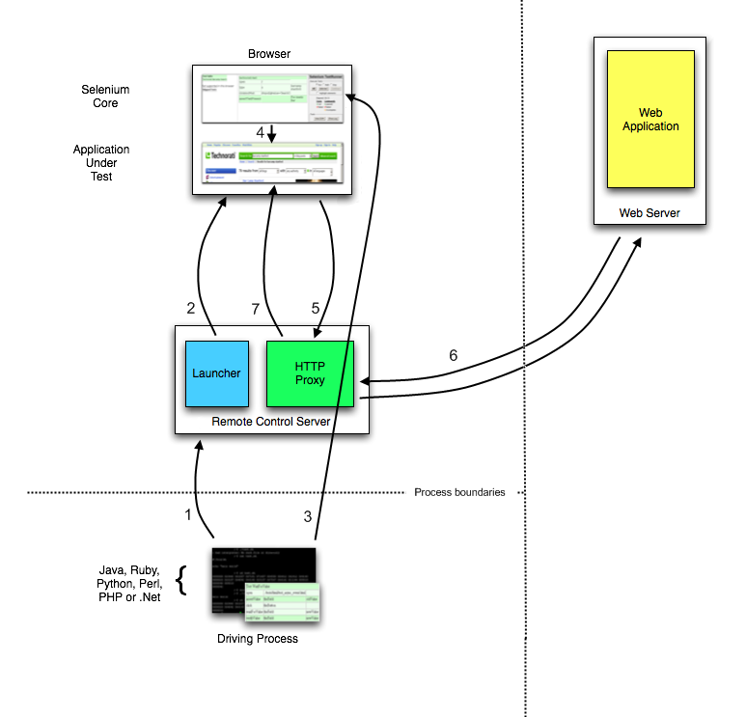
Selenium RC - Architecture
http://www.seleniumhq.org/docs/05_selenium_rc.jsp
http://www.seleniumhq.org/docs/05_selenium_rc.jsp

Slide 18
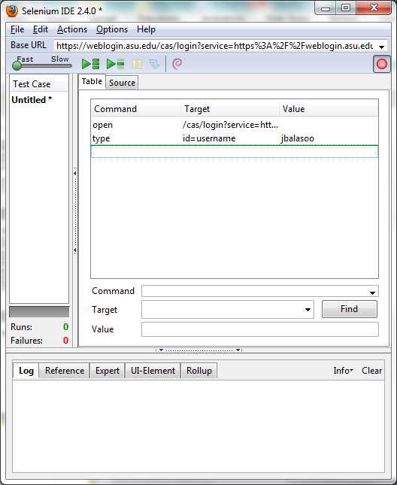
Selenium - IDE
URL
Commands
/Data
Log Area

Slide 19
Selenium IDE Example
Demo

Slide 20
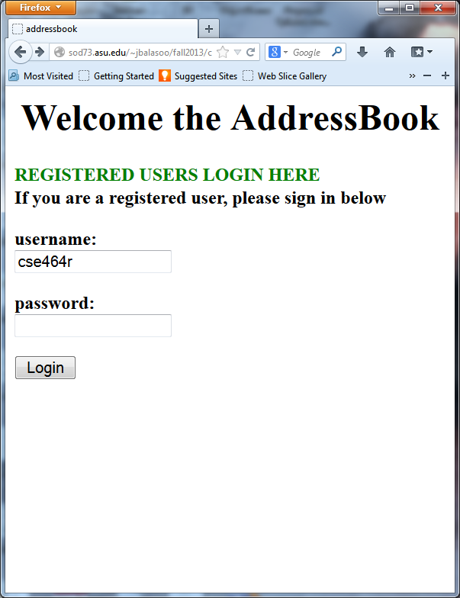
Testing Login Functionality

Slide 21
Selenium WebDriver Demo

Slide 22
Next Time: More About Selenium Testing
More about selenium web driver
  Locating web elements
  Working with web elements (mouse, keyboard interactions)
  Navigation (back and forward)
SQL Injection and Security Testing for Web Applications

